Slide 1

An interpretable machine learning approach to multimodal stress detection in a simulated office environment
Mara Naegelin , Raphael P. Weibel , Jasmine I. Kerr , Victor R. Schinazi , Roberto La Marca , Florian von Wangenheim , Christoph Hoelscher, Andrea Ferrario
By: Samana Fatima

Slide 2
Table Of Contents
Introduction
Methodology
Results
Limitations
Conclusion
Take-home message
References

Slide 3
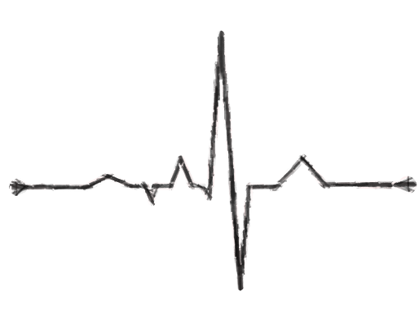

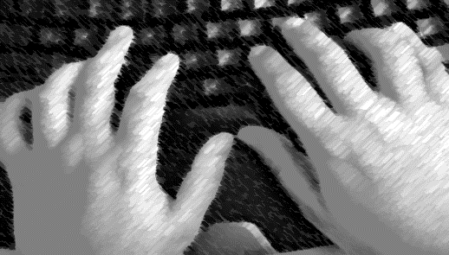
Objective
Machine learning methodology for stress detection based on multimodal data
Collected from unobtrusive sources in an experiment simulating a realistic group office environment
Mouse movement/ clicks
Keyboard typing/style
Heart Rate

Slide 4

What Is Stress?
A common experience
Body’s reaction to challenges: Fight or flight response
Effects on mind:
Short term or long term

Slide 5
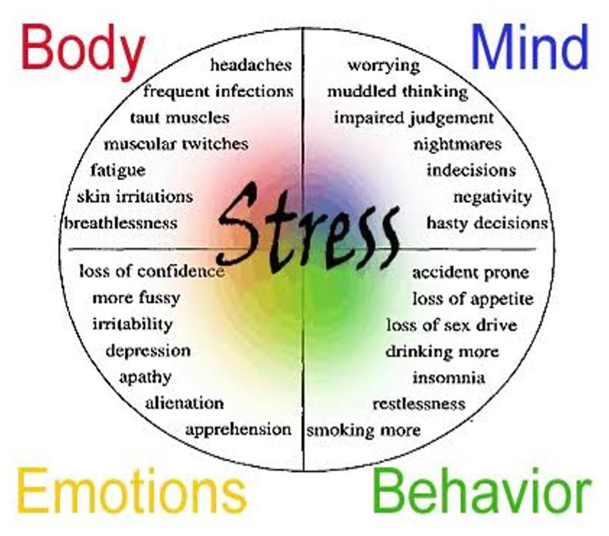
Stress response
Psychological
Physiological
Behavioral

Slide 6

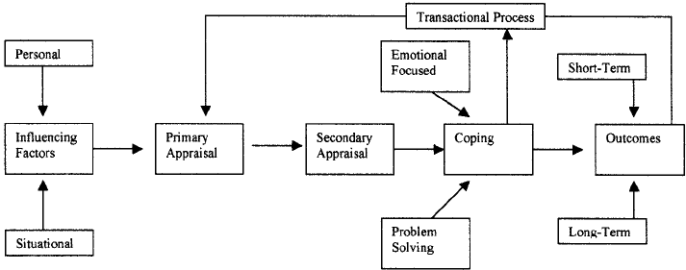
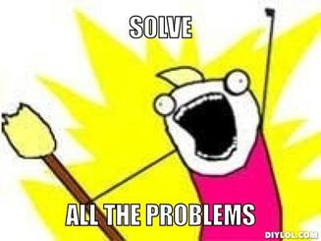
Lazarus and Folkman's Transactional Model of Stress and Coping
Our reaction has a powerful impact
Objective appraisal and coping strategies
(Schuster et al., 2003)
How will this event affect my well-being?
Do I have the ability to cope?

Slide 7
Misalignment of Psychobiological Stress Responses
Closely associated with one another, they do not always align
Psychological responses: emotions and thoughts
Physiological responses: increased heart rate or sweating

Slide 8
Solution?
Multimodal data collection
Reliable and continuous
Physiological signals (heart rate variability) and behavioral indicators (e.g., mouse and keyboard usage)
Ensures necessary information
Improves accuracy

Slide 9
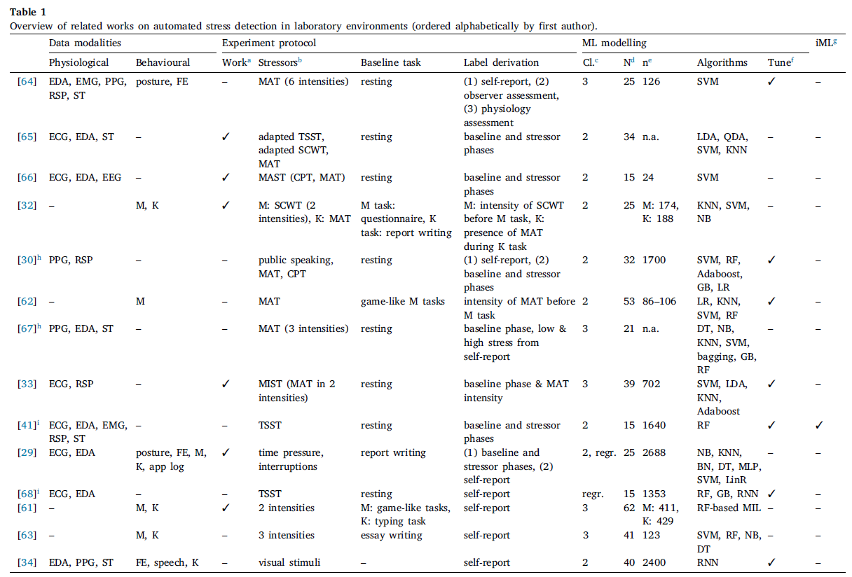
Related
Work

Slide 10

Limitations in Previous Studies
Realism of tasks
Baseline and resting phases: may not have accurately reflected the typical workload or relaxation experienced in real work settings
Tasks used were often artificial and simplistic
Single-participant setups
Notes:
Overall, the experimental setup may lack generalizability to real office environments due to the artificial nature of stress induction, the tasks performed, and the absence of social dynamics.

Slide 11
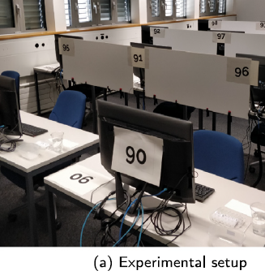
Lab Experiment
Ninety participants (44 female)
ETH Zurich’s Decision Science Laboratory was modified to mimic a real-world group office environment

Slide 12
Procedure
Session 1
Session 2
Session3
N = 30
N = 30
N = 30
Stress Condition 2
Stress Condition 1
No Stress
Control
N = number of participants

Slide 13
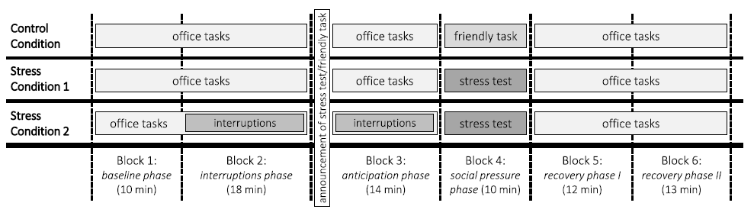
Protocol
Stressful conditions involved a job interview-like scenario
Easy situation was framed as professional training
Informed about the upcoming stressful situation 20 minutes in advance
Stress condition 2 received frequent text messages - round 2 and 3

Slide 14
Machine Learning (ML) Pipeline
Data Collection and Feature Selection
Data Preprocessing
Model Selection
Model Training
Model Evaluation
Monitoring and Maintenance

Slide 15
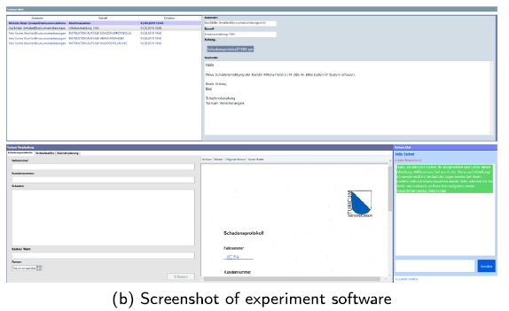

Data Collection and Feature Derivation
Psychological Data: Self-assessments using questionnaires
Physiological Data: Heart rate variability (HRV) captured with Firstbeat Bodyguard 2 devices.
Behavioral Data: Mouse and keyboard interactions logged with custom software

Slide 16

Data Preprocessing
Observations: 6776
Feature extraction: mouse, keyboard, and HRV data (59)
User normalization: adjusted data to account for individual differences
Label derivation: perceived stress, valence, and arousal levels

Slide 17
Model Selection
Stress levels
Perceived stress
Low
Medium
Valence
Negative
Low
High
Arousal
Medium
High
Neutral
Positive
Binary classification : stressed and non-stressed
Multiclass classification : more than two categories, providing more detailed levels of stress

Slide 18
ML Algorithms
Support Vector Machines
Random Forests
LightGBM (Gradient Boosting Machine)

Slide 19

Support Vector Machines (SVM)
Powerful for classification tasks
Technique: Kernel trick
Finds optimal hyperplane for separation
Python package ‘scikit-learn’
(Saini, 2024)
Notes:
SVM is like drawing a line (or a curve) that best separates the data into different classes. It tries to find the widest possible gap between different groups of data points. The kernel function helps SVM handle complex data by transforming it into a space where it’s easier to separate.

Slide 20
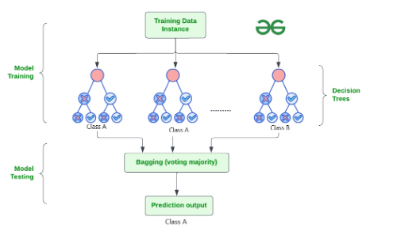
Random Forests (RF)
Ensemble method: Collection of decision trees
Group decision-making process
Resistant to overfitting
Provides insights into feature importance
Python package ‘scikit-learn’
(GeeksforGeeks, 2024)
Notes:
Random Forests use many decision trees to make predictions. Each tree gives a "vote" for the predicted class, and the most voted class is the result. By combining the trees, the model becomes more accurate and less likely to be influenced by noisy data.

Slide 21
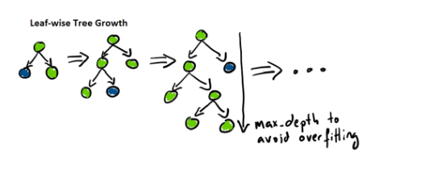
LightGBM (Gradient Boosting Machine)
Decision tree structure
Splits the tree leaf wise
Gradient boosting: Learns from its mistake
Handles large datasets
One of the fastest ML methods
Python package ‘lightgbm’
(Serengil, 2021)
Notes:
LightGBM is a powerful tool that builds one tree at a time, each correcting mistakes from the previous one. It’s designed to be faster and more efficient, especially with large datasets. It looks for the best way to split the data by focusing on the most important parts first.

Slide 22
Model Training and Evaluation
10-fold Cross-Validation: Tuned hyperparameters
Class imbalance: SMOTE (Synthetic Minority Oversampling Technique) - generates synthetic samples for the minority classes to balance the training dataset
Performance metrics

Slide 23
Criteria for Model Selection
Accuracy
How often the model is correct
F1 Score
balances precision and recall
Area Under Curve
(AUC)
distinguish between classes
Higher Accuracy = Correct Prediction

Slide 24
Understanding ML Models
Can find complex patterns in data
decision-making process not clear
lack of transparency can be a problem
WHY?
Debugging and validation
Trust and adoption

Slide 25
Interpretable Machine Learning (iML)
Model’s decisions are easier to understand
Strengthens trust and usability
Feature attribution: a common iML approach
- > Identifies important features to make predictions
Limitations:
It doesn't explain individual predictions
Different calculation methods can give inconsistent result
Notes:
How It Works: Each feature gets a weight based on its importance in the model’s decisions. For example, in a model predicting house prices, features might include the number of bedrooms, location, and size of the house. The model might determine that the number of bedrooms is very important and give it a high weight.

Slide 26
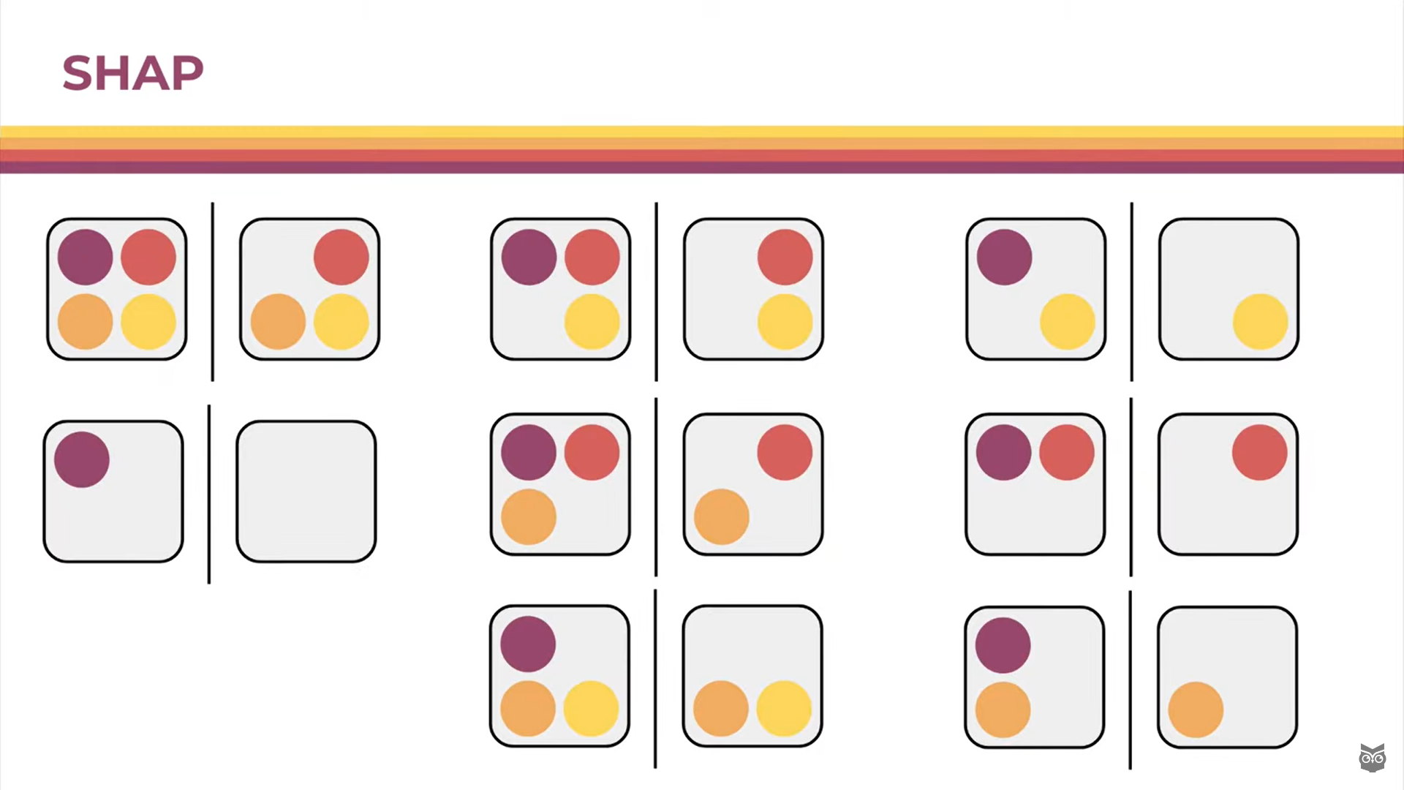
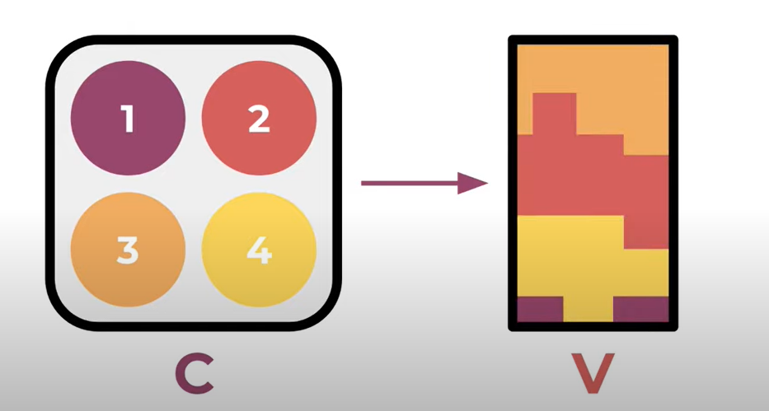
SHapley Additive exPlanations (SHAP)
Popular iML method
Helps explain individual model predictions
Accurate explanations, handle missing features well

Slide 27
Visualizing SHAP Values
Beeswarm Plot
Dependence Plot
Global Plot
overall importance of each feature across all predictions
impact of each feature on all predictions
Illustrates the relationship between a specific feature and the prediction

Slide 28
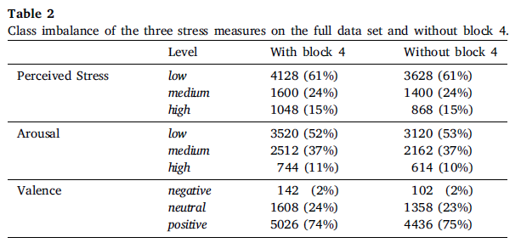
Preprocessed Data Set
Perceived Stress: Most data points indicate low stress
Arousal: Most data points indicate low arousal
Valence: Most data points indicate positive valence

Slide 29
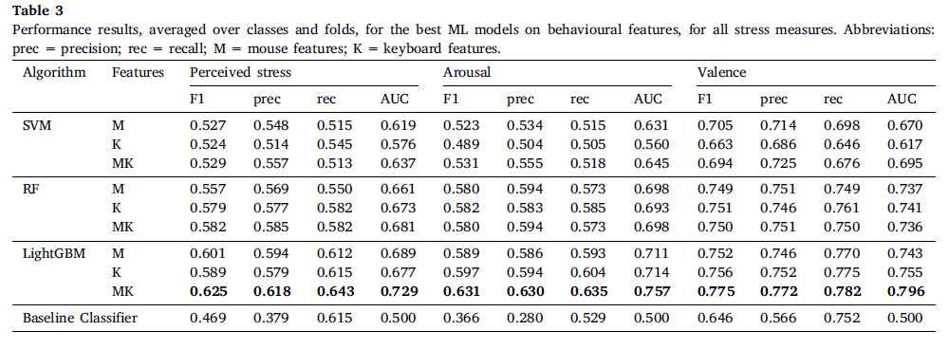
Performance results
the best-performing models are chosen by considering the weighted average F1 score

Slide 30
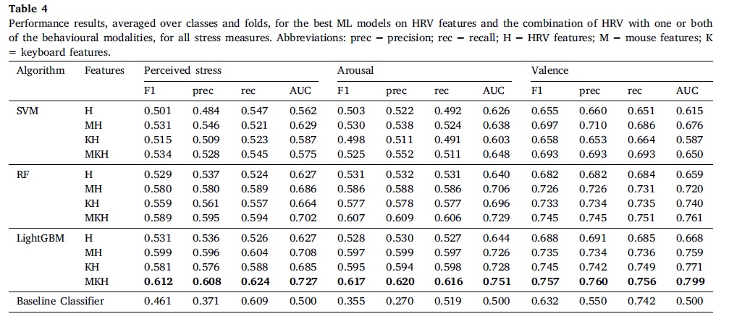
Performance results
LightGBM : performs best
RF : Slightly better performance than LightGBM for HRV only
SVM : Perform worse when combining HRV with keyboard features for arousal.

Slide 31
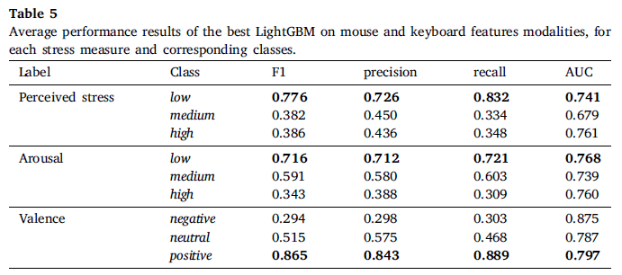
Performance results
Medium and high arousal/perceived stress: lower performance as class imbalance increases
Notes:
Table 5 essentially shows us how well the LightGBM model can predict different stress levels, considering that the data might not have an equal number of examples for each level of stress. It tells us if the model is better at predicting certain stress levels than others and gives us an idea of its overall performance.

Slide 32
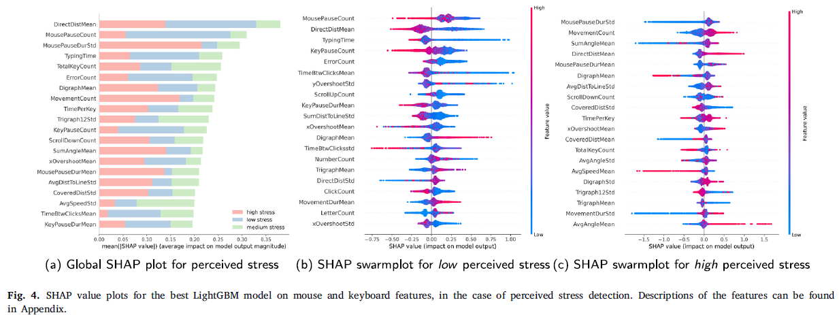
SHAP Plots for Perceived Stress

Slide 33
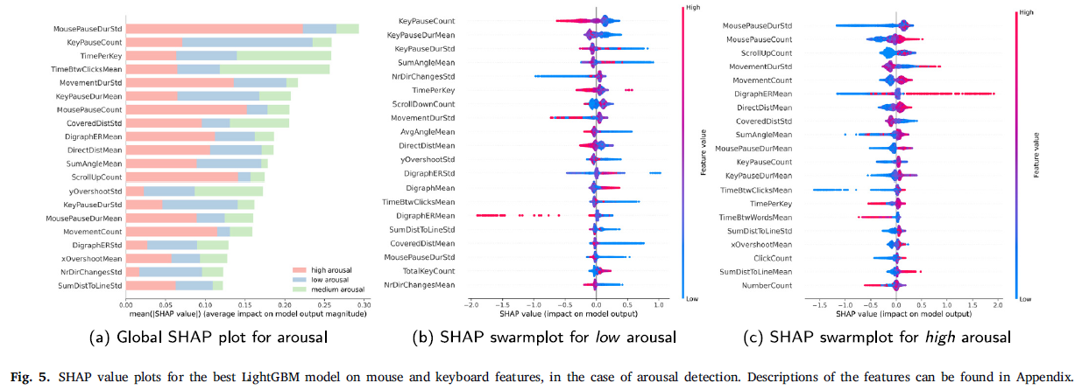
SHAP Plots for Arousal

Slide 34
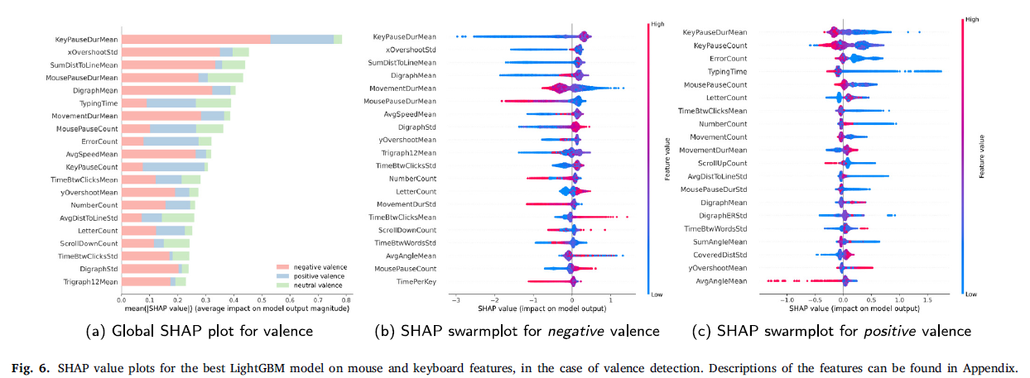
SHAP Plots for Valence

Slide 35
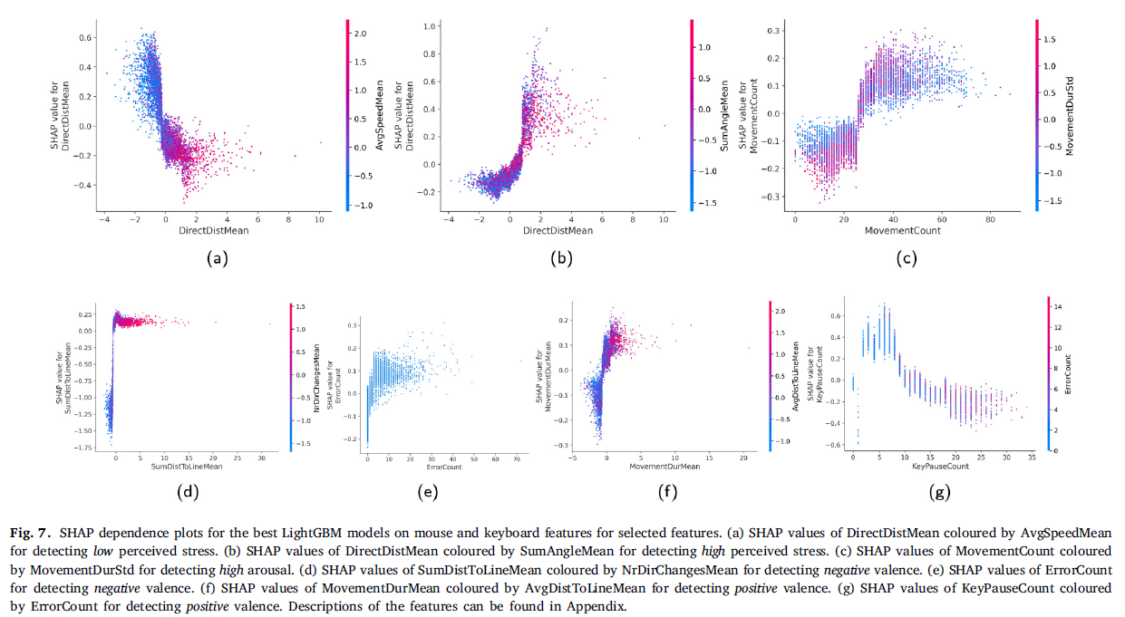
SHAP Dependence Plots
Notes:
Shorter distance contributes positively to low perceived stress
c) Contributes to increased high arousal

Slide 36

Limitations
Single session experiment
Hypothetical scenario: simplified tasks
Healthy and young participants
Short duration
Unfamiliar software
Firstbeat bodyguard 2 devices – not practical
Limited data size

Slide 37
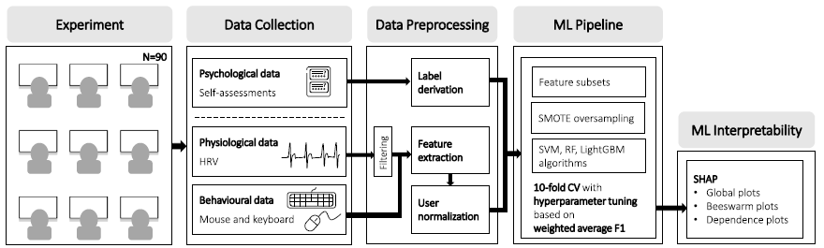
Conclusion
Ml-based methodology for stress detection
Realistic office environment experiment
Robust performance with lightgbm
Behavioral patterns revealed by SHAP values

Slide 38
Take-home Message
More research is needed in actual office settings with diverse employee groups
Future studies should use wearable devices: comfortable for daily use
This research was a step towards creating an effective, real-time stress management tools for the workplace, but real-world testing is the next crucial step.

Slide 39
References
Schuster, R. M., Hammitt, W. E., & Moore, D. (2003). A theoretical model to measure the appraisal and coping response to hassles in outdoor recreation settings. Leisure Sciences, 25(2–3), 277–299. https://doi.org/10.1080/01490400306568
Saini, A. (2024, May 22). Guide on Support Vector Machine (SVM) Algorithm. Analytics Vidhya. https://www.analyticsvidhya.com/blog/2021/10/support-vector-machinessvm-a-complete-guide-for-beginners/
GeeksforGeeks. (2024, February 22). Random Forest algorithm in machine learning. GeeksforGeeks. https://www.geeksforgeeks.org/random-forest-algorithm-in-machine-learning/
Serengil, S. (2021, December 25). A gentle introduction to LightGBM for Applied Machine Learning. Sefik Ilkin Serengil. https://sefiks.com/2018/10/13/a-gentle-introduction-to-lightgbm-for-applied-machine-learning/

Slide 40
Thankyou

